Slide 1


Web Development with .NET 6
Isaac Levin
Notes:
ASP.NET Core 3.0 is loaded with new features for building modern web applications and services. In this session, we'll show you how to use ASP.NET Core 3.0 to build beautiful and interactive client-side web UI with Blazor backed by high-performance gRPC microservices and long-running worker service processes. We’ll show you how to secure your APIs with IdentityServer integration, use SignalR for client-to-server streaming and take advantage of the latest performance improvements.

Slide 2
ASP.NET Core: Modern .NET web stack
Web UI
Services
Extensions
MVC
Razor Pages
SPA
Blazor
HTTP APIs
SignalR
gRPC
Logging
Configuration
Middleware
Routing
Security
Localization
Caching
Options
Compression
Session
Health Checks
…
File Providers
Servers
Worker
Services
Kestrel
IIS
HTTP.sys
Dependency Injection
Hosting
Notes:
ASP.NET Core comes with everything you need to build beautiful web UI and powerful backend services. The addition of Blazor to ASP.NET Core expands the reach of your .NET web apps to the client.

Slide 3
ASP.NET Core in .NET 6 highlights
Simplified getting started experience with minimal APIs
Be more productive with .NET Hot Reload
Faster performance, lower memory usage
Better integration with frontend JavaScript frameworks
Improved support for client web UI with .NET & Blazor

Slide 4
Get started faster with ASP.NET Core
var app = WebApplication.Create();
app.MapGet("/", () => "Hello World!");
await app.RunAsync();
Single C# file
Simplified host setup
Minimal APIs
Latest C# features

Slide 5
Performance
HTTP APIs – pay for play
~5% RPS gain for middleware in .NET 6
New min API twice as fast as API controllers
Faster JWT authentication
~40% faster gain in JWT middleware
MVC on Linux
~12% faster thanks to faster logging
More efficient MemoryCache
~10% RPS gain on cache TechEmpower benchmark
Reduced memory usage per https connection
~70% working set reduction for idle WebSocket connections
HTTP/2 & gRPC
Improvements to HttpClient connection management
~20% faster Protobuf serialization

Slide 6

Productivity
Faster build and startup performance
New Razor source generator
Edit & Continue (EnC)
.NET Hot reload

Slide 7
Razor Pages

Slide 8
Razor Pages
Runs on all the same MVC infrastructure
Better encapsulation and grouping of UI details
Fewer folders and files
MVC
Razor Pages
/Controllers/CartController.cs
/ViewModels/CartViewModel.cs
/Views/Cart/Index.cshtml
3 Root Level Folders
/Pages/Cart/Index.cshtml
Index.cshtml.cs
1 Root Level Folder
Notes:
Reference (MSDN Magazine September 2017 - https://msdn.microsoft.com/en-us/magazine/mt842512)

Slide 9
@page
@using RazorPages
@model IndexModel
<p> @Model.Message </p>
using Microsoft.AspNetCore.Mvc.RazorPages;
using System;
namespace RazorPages {
public class IndexModel : PageModel
{
public string Message { get; private set; } = "Hello. ";
public void OnGet()
{
Message += $" Server time is { DateTime.Now }"; }
}
}
Notes:
https://docs.microsoft.com/en-us/aspnet/core/mvc/razor-pages/

Slide 10
MVC

Slide 11
What’s (pretty much) the same
MVC developer flow
Models / Views / Controllers
Routing / Attribute Routing
HTML Helpers

Slide 12
What’s Changed
No web.config (configuration)
No Global.asax or App_Start
No CSS / JS in project root (wwwroot)
bower and bowerrc
bundleconfig.json
New Program.cs / Startup.cs
Run with IISExpress / Kestrel

Slide 13
Whats new in .NET 6 for MVC & Razor Pages
CSS isolation
Async streaming
IAsyncDisposable
Bootstrap 5.1
Improved OpenAPI support
Optional parameters for View Component tag helpers

Slide 14
What’s new
(some aren’t MVC features but are useful for MVC dev)
Views get TagHelpers
DI more thoroughly integrated
Globalization / localization
MVC + APIs merged

Slide 15
Tag Helpers

Slide 16
TagHelpers
HTML helpers expressed as tags
Ex. Instead of:
@Html.LabelFor(m => m.UserName, new { @class = "col-md-2 control-label" })
Write this:
<label asp-for="UserName" class="col-md-2 control-label"></label>
Easier to customize with additional attributes
Work seamlessly with the HTML editor

Slide 17
TagHelpers
@using (Html.BeginForm(new { ReturnUrl = ViewBag.ReturnUrl })) {
@Html.AntiForgeryToken()
@Html.ValidationSummary(true)
<fieldset>
<legend>Log in Form</legend>
<ol>
<li>
@Html.LabelFor(m => m.UserName)
@Html.TextBoxFor(m => m.UserName)
@Html.ValidationMessageFor(m => m.UserName)
</li>

Slide 18
TagHelpers
<form anti-forgery=“true“ validation-summary=“true” action="Create“>
<fieldset>
<legend>Log in Form</legend>
<ol>
<li>
<label for=“UserName”>
<input for=“UserName”>
<span validation-for="Name" style="color:blue" />
</li>

Slide 19
TagHelpers: Create Your Own
public interface ITagHelper
{
int Order { get; }
Task ProcessAsync(TagHelperContext context, TagHelperOutput output);
}
Examples: https://github.com/aspnet/Mvc/tree/dev/src/Microsoft.AspNet.Mvc.TagHelpers

Slide 20
Single page apps (SPA)
Angular 12, React 17
Leverage webpack dev server proxy support
Establish a common pattern for community SPA templates

Slide 21
Blazor

Slide 22
Blazor in .NET 6
.NET Hot reload
State persistence during prerendering
Error boundaries
WebAssembly AOT
Runtime relinking
Native dependencies
Smaller download size
Render components from JS
Custom event args
JavaScript initializers
JavaScript modules per component
Infer generic types from parent
Generic type constraints
Handle large binary data
Remove SignalR message size limitations
Required parameters
Handle query string parameters
Influence the HTML head
SVG support

Slide 23
Other ASP.NET Core improvements
HTTP/3 (preview) - New QUIC transport to address head-of-line blocking
More control over socket creation and handling
Strongly-typed header APIs
Shadow copying for IIS deployments
HTTP & W3C logging
New SignalR C++ client
gRPC retries & load balancing

Slide 24



ASP.NET Core: A full stack solution
Client
Frontend
Backend
http://..
gRPC
gRPC
Worker
ASP.NET Core
Blazor
Components
SPA (JavaScript)
MVC / Razor Pages
Web APIs
SignalR
Security & identity
Worker services
gRPC

Slide 25
Pizza store app architecture
gRPC
Order status
http://..
Worker
ASP.NET Core
Pizza Workers
Queue

Slide 26
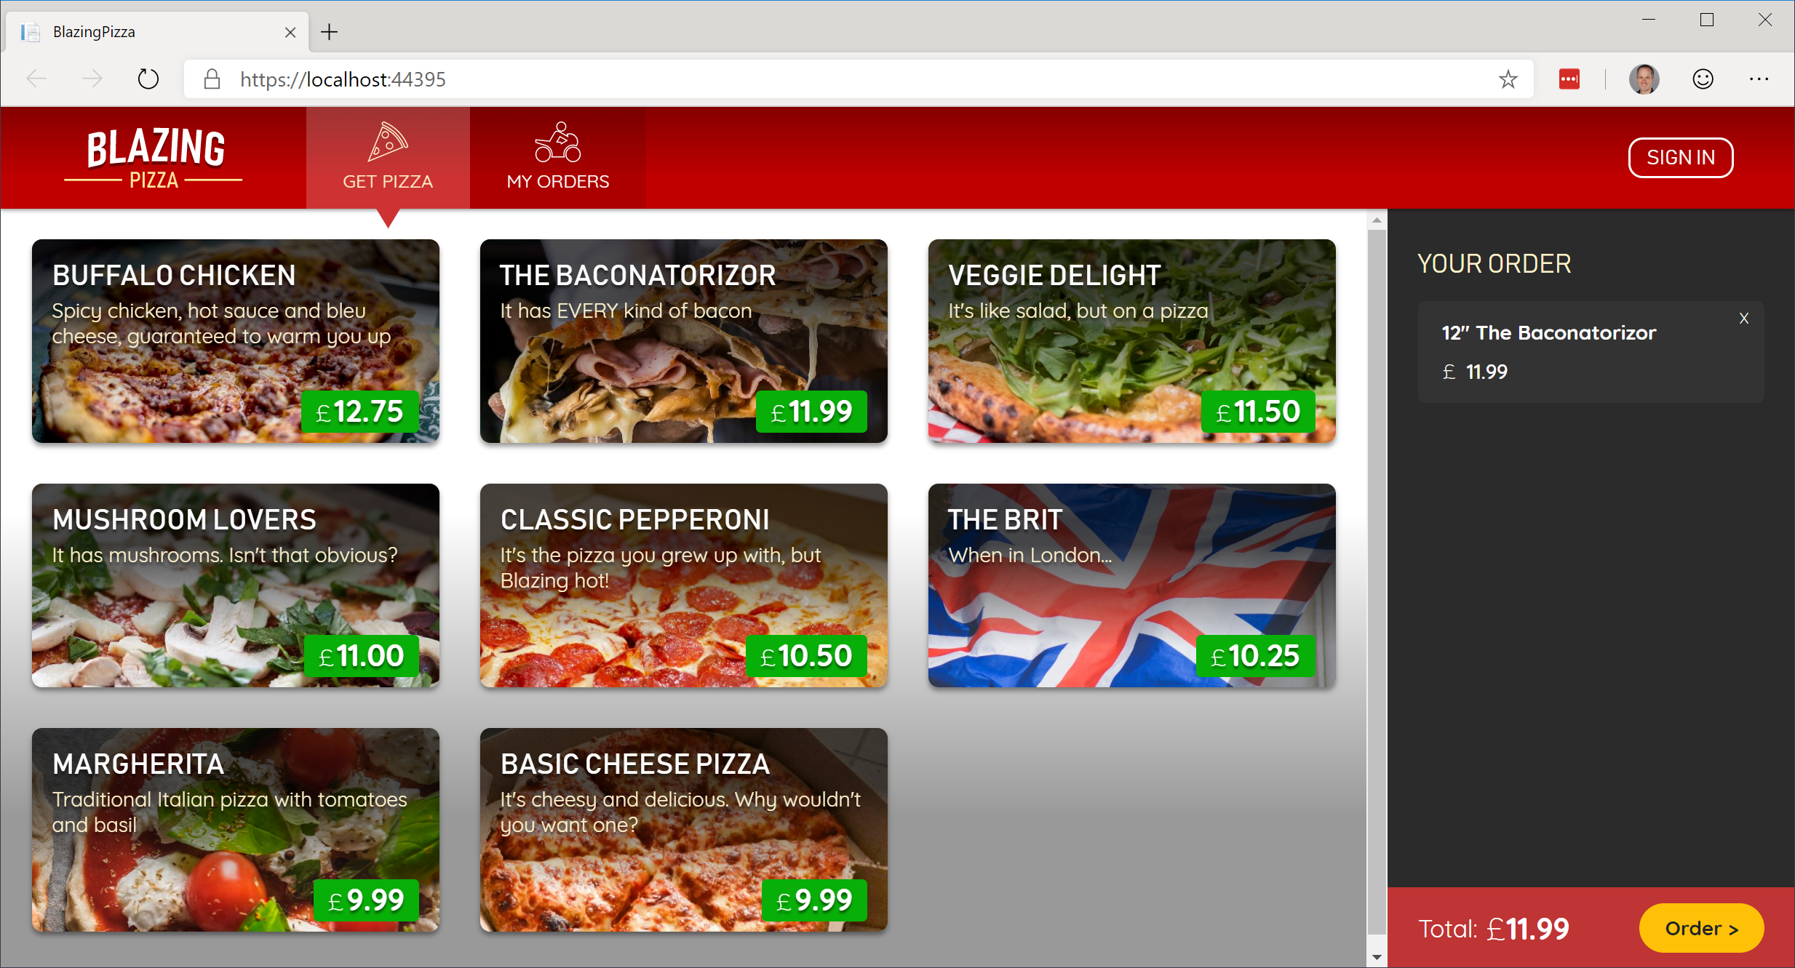
Build your own pizza store UI with Blazor
https://aka.ms/blazorworkshop

Slide 27


Pages & Views with Components
ASP.NET Core
Request
https...
Page / View
HttpContext
SignalR
Component
UI events / DOM updates
DOM
State
Response

Slide 28
Authentication for SPA templates
Built-in client UI for login/logout
Easily protect server-side APIs
Protect specific parts of your client-side app from unauthorized access
Powered by IdentityServer
Notes:
Demo:
Show existing Angular + Auth app
Click on FetchData, redirects to login
Register user (using link below)
See FetchData page with logged in username
Click on user to see profile
Click on app home page link
Logout
Show code
Startup: DB, Identity, IdentityServer, API authorization setup
Angular: authorization module, route guard, token provider

Slide 29
Pizza store app architecture
gRPC
Order status
http://..
Worker
ASP.NET Core
Pizza Workers
Orders Queue

Slide 30
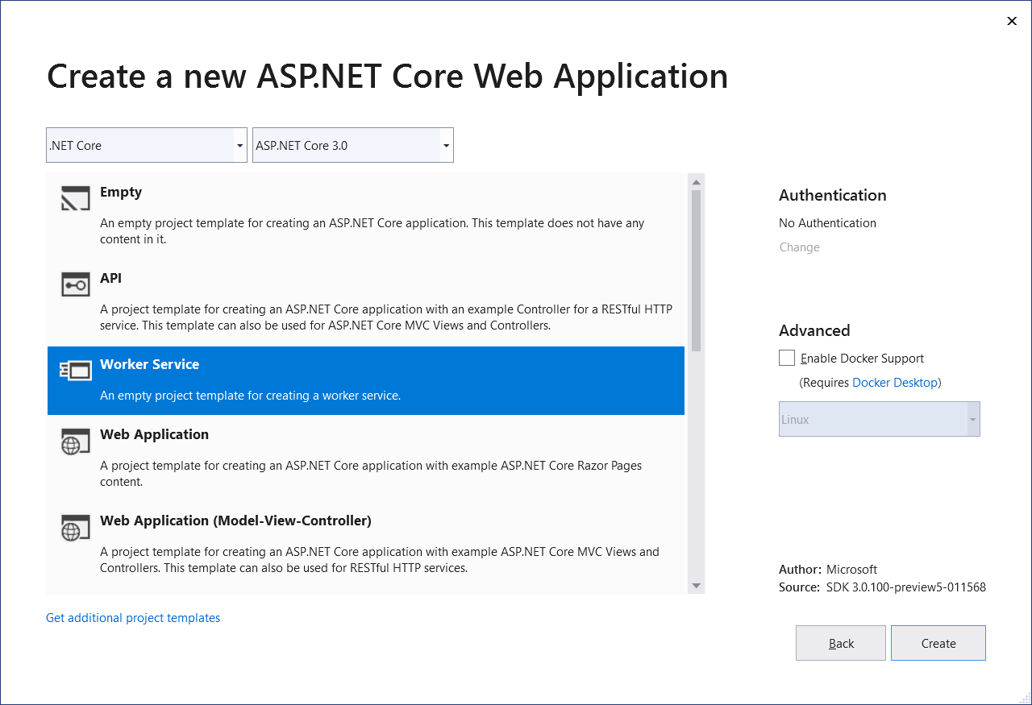
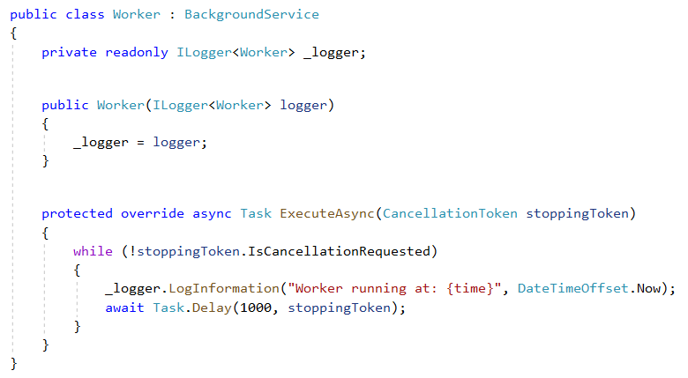
Worker services
New Worker service template
Build long-running worker processes
May or may not have endpoints
Host in Windows services, systemd, WebJobs, containers
Integrates with configuration, logging, dependency injection

Slide 31
Pizza store app architecture
gRPC
Order status
http://..
Worker
ASP.NET Core
Pizza Workers
Orders Queue

Slide 32
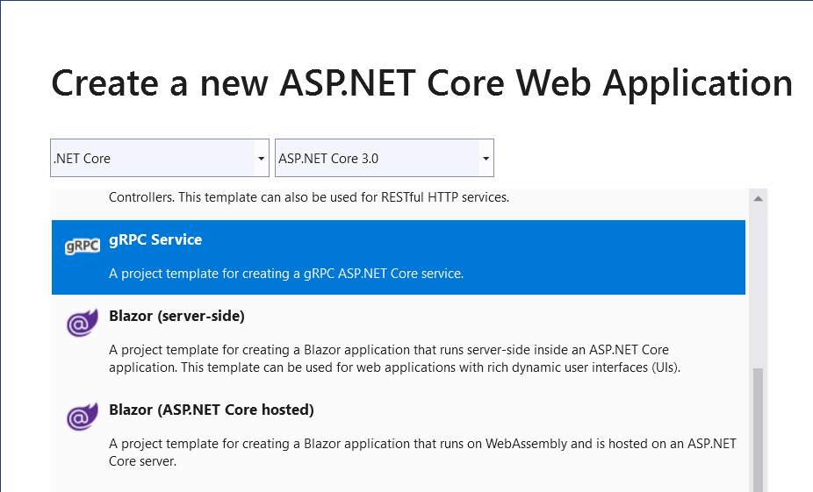
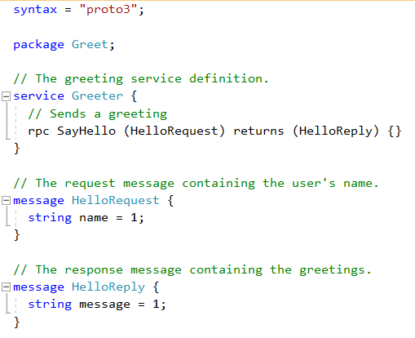
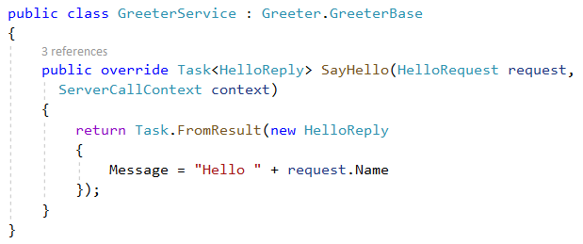
gRPC
High performance, contract-based RPC services
Broad interoperability for polyglot environments
Great for service-to-service communication

Slide 33



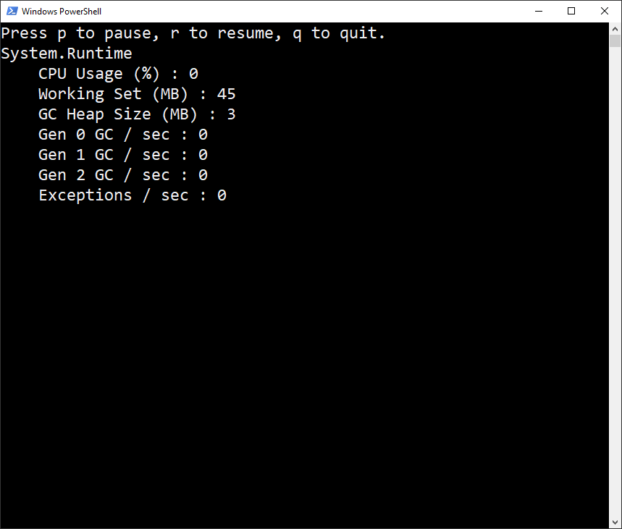
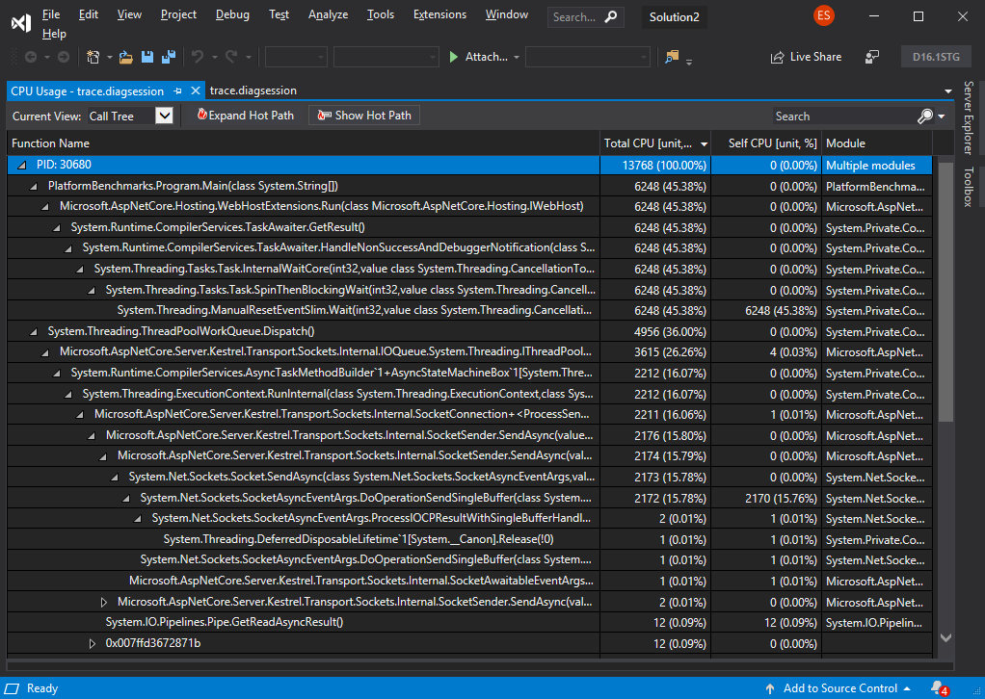
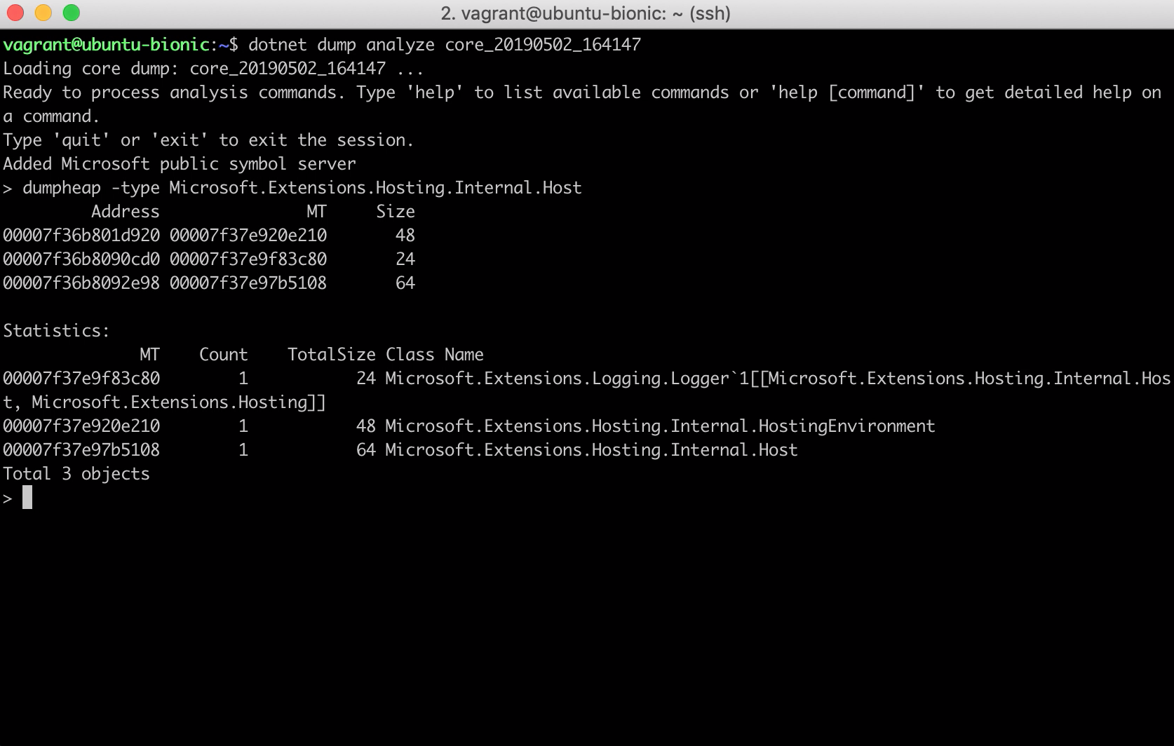
Diagnostics
Counters
Traces
Dumps
dotnet counters
dotnet trace
dotnet dump
Runtime emits metrics via EventCounters
Ad-hoc analysis and monitoring
ASP.NET Core specific counters coming soon
Generate portable trace files
Analyze with perfview, Visual Studio, or third-party apps (speedscope.app)
Collect .NET Core process dumps
Analyze dumps with an interactive REPL (hosted version of SOS)

Slide 34
Try .NET 6 with ASP.NET Core & Blazor today!
Download: https://dotnet.microsoft.com/download
Visual Studio: https://visualstudio.com/preview
Docs: https://docs.asp.net
Blazor: https://blazor.net
Workshop: https://aka.ms/blazorworkshop

Slide 35
Lab
Razor Pages

Slide 36
Lab
Tag Helpers

Slide 37
Lab
SPA

Slide 38
Lab
Blazor

